Slide 1

Building responsible robotics, AI, and agents
Victor Cho
CEO Emovid

Slide 2
THE FLOW
RESPONSIBLE BUSINESSES
RESPONSIBLE TECHNOLOGY
A PERSONAL EXAMPLE

Slide 3

1. responsible BUSINESSES

Slide 4


the four stakeholders
SHAREHOLDERS
CUSTOMERS
SOCIETY
EMPLOYEES

Slide 5



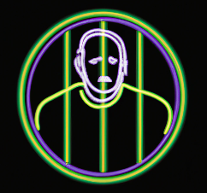
SAINTS CITIZENS MERCENARIES CRIMINALS
MY PERSONAL FOCUS

Slide 6

Balancing all stakeholders = maybe the hardest part of the job

Slide 7
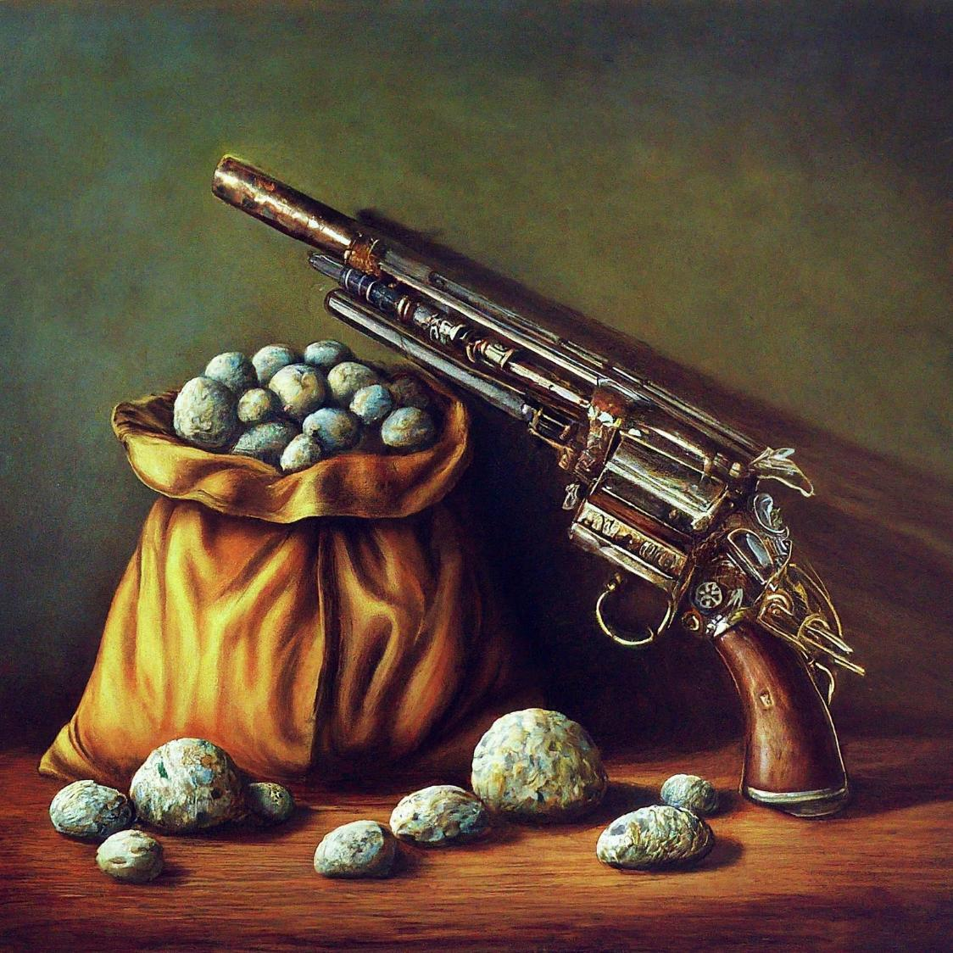
2. responsible TECH

Slide 8
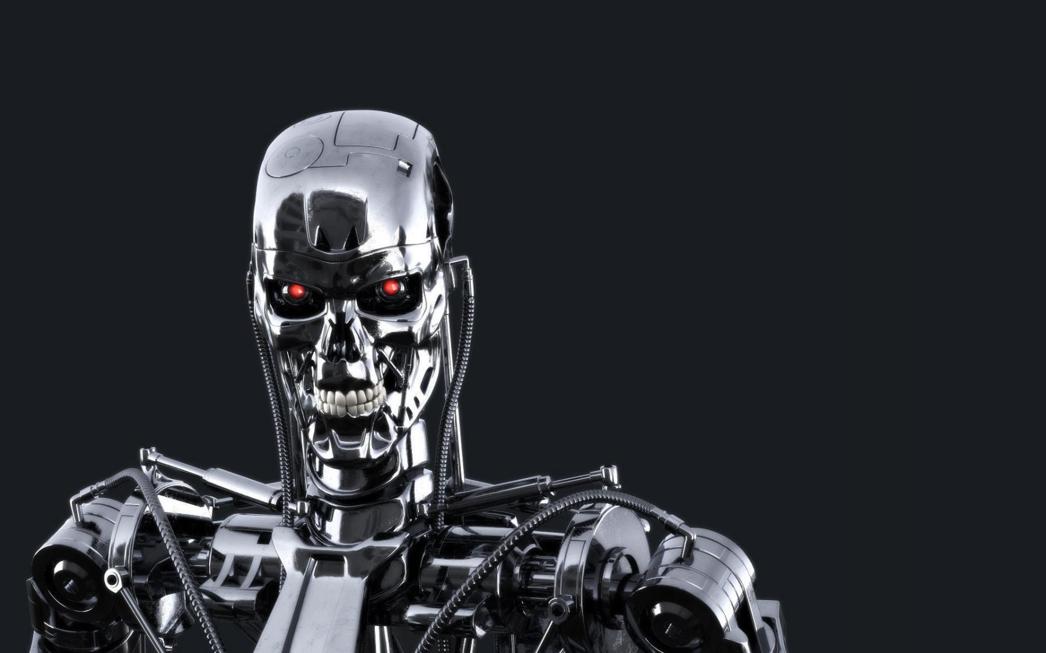
Let’s go build some autonomous weapon systems!

Slide 9
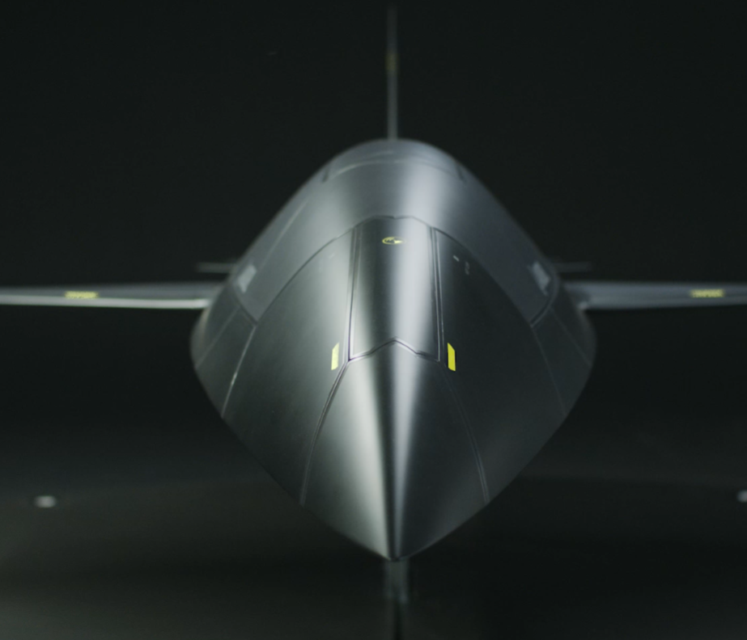
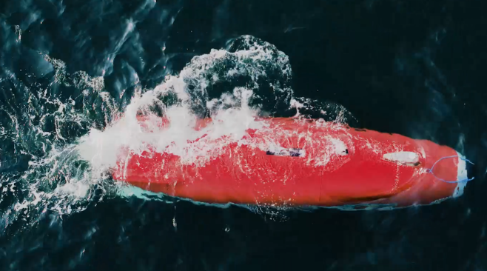
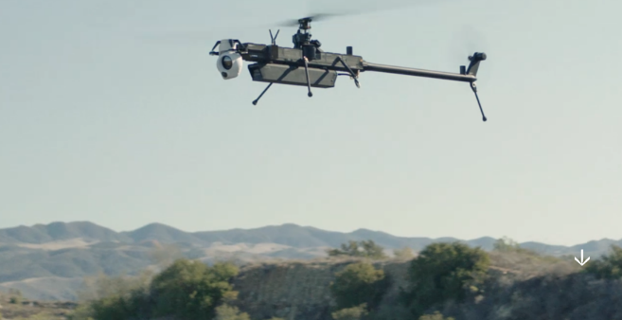
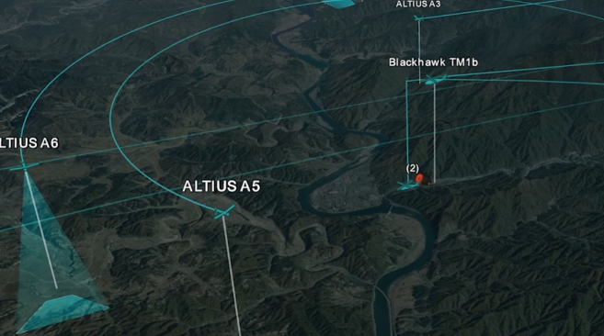

Slide 10
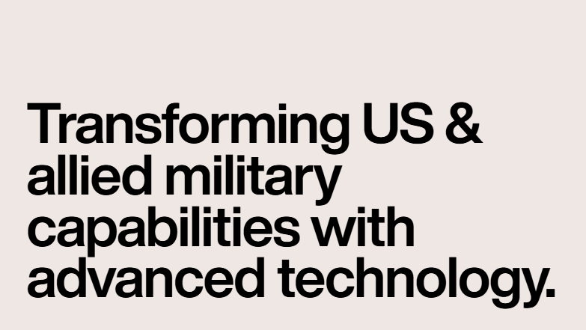

But wait…

Slide 11
ETHICAL TECHNOLOGY
1. Built to do something good
2. Contained and controlled 2nd-order impacts

Slide 12
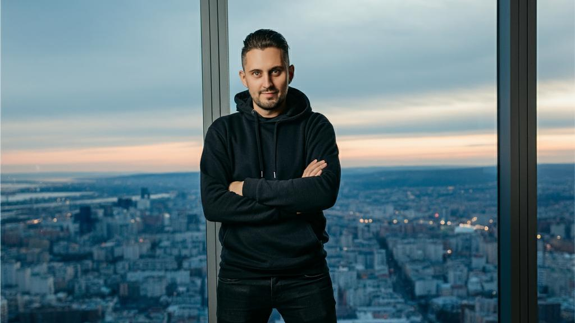
THE TECH BRO (PER AI)

Slide 13
SAINTS CITIZENS MERCENARIES CRIMINALS
TECH BRO FREE

Slide 14
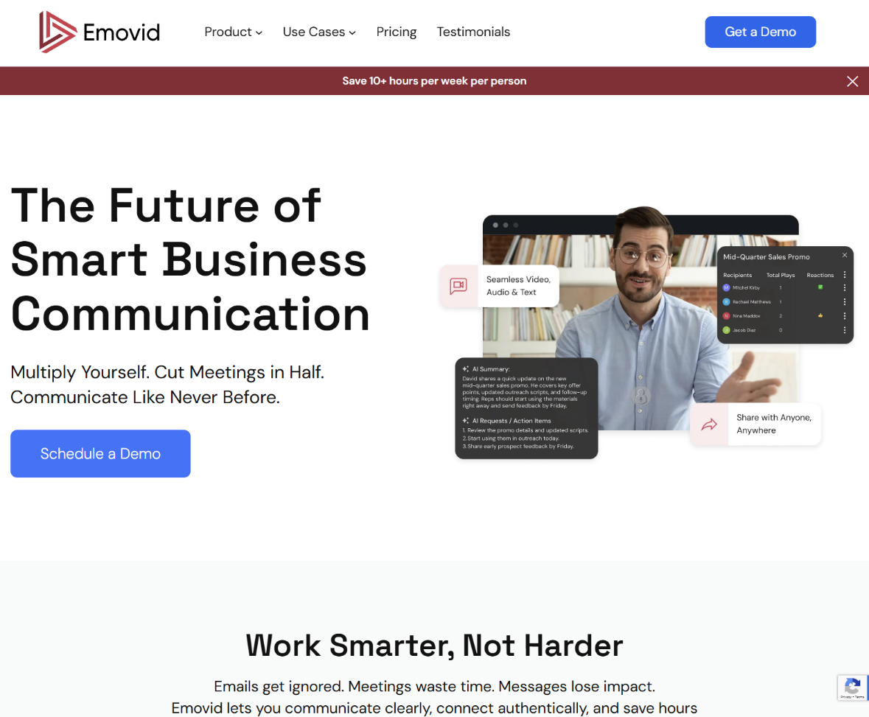
3. A PERSONAL example: Emovid

Slide 15
IMPACT OF AI
An innovation wave that will bring massive 2nd-order impacts

Slide 16





Our purpose and passion
To amplify business productivity through the power of authentic communication
Short, asynchronous
videos
Patent pending

Slide 17


We are building the fourth mode of digital communication
VIDEO
4
3
Video Conferencing
Multi-modal messaging
REAL TIME
ASYNCHRONOUS
2
1
Slack/SMS
E-mail
TEXT

Slide 18

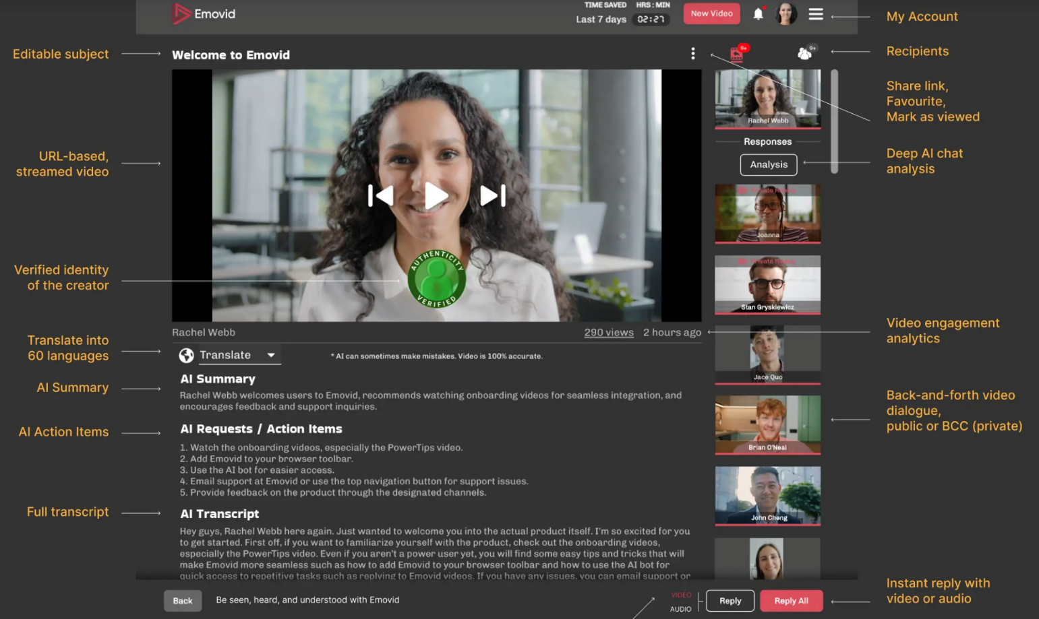
Emovid: Free-up 10+ hours/week

Slide 19


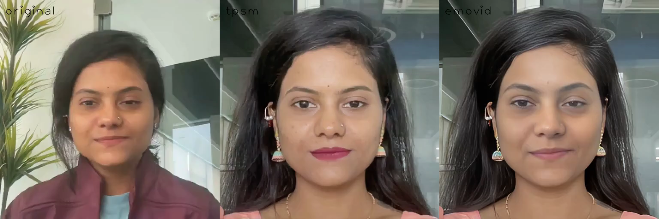
Maintaining authentic voice and expression transfer in video

Slide 20
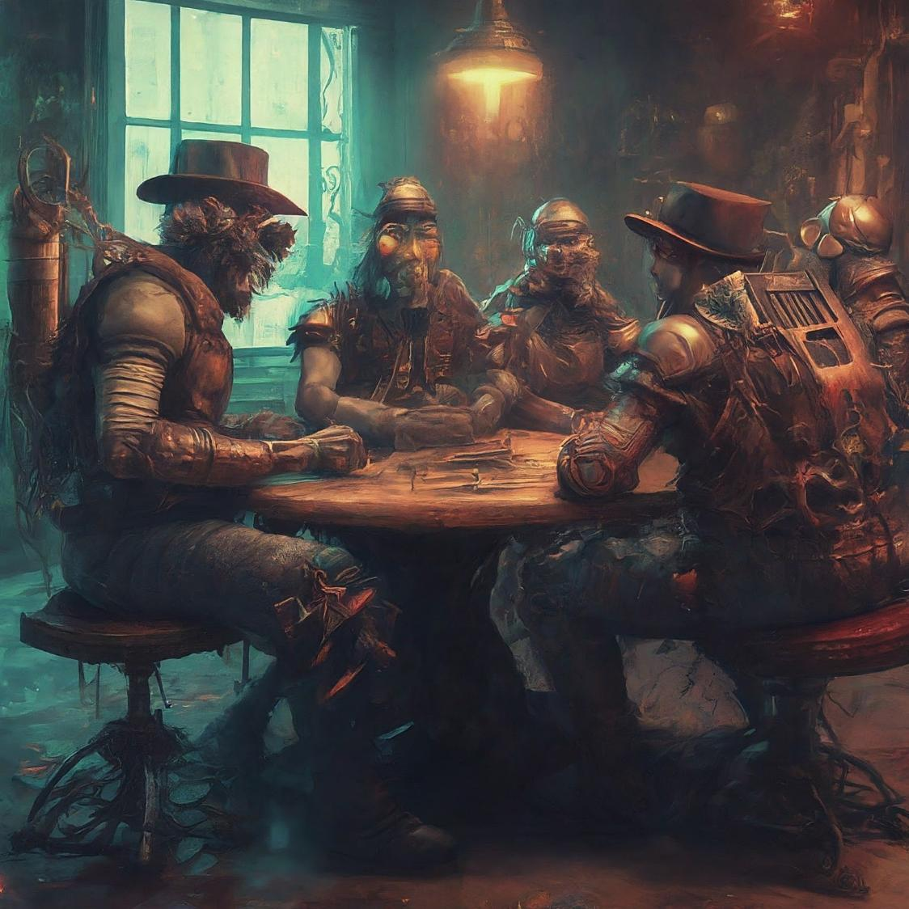
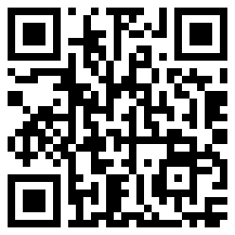
THANK YOU
MORE INFO:
WWW.4THSTAKEHOLDER.COM
VICTOR@EMOVID.COM
SEND ME A VIDEO MESSAGE

